Slide 1
CELLULAR AUTOMATA
TOC PROJECT VIDEO-1
SURAJ P
19BCE1044

Slide 2
WHAT ARE CELLULAR AUTOMATA?
A cellular Automaton is a discrete model similar to any other automaton which has its own start state(s) and a set of rules.
A cellular automaton is a model of a system of "cell" objects with following characteristics :

Slide 3
CHARACTERISTICS OF CELLULAR AUTOMATA
The cells live on a grid which can be either 1D or even multi dimensional
Each cell has a state. The number of state possibilities is typically finite. The simplest example has the two possibilities of 1 and 0
Each cell has a neighbourhood but it is typically a list of adjacent cells.

Slide 4
WORKING OF A CELLULAR AUTOMATON
An initial state (time t=0) is selected by assigning a state for each cell
A new generation is created (advancing t by 1), according to some fixed rule that determines the new state of each cell in terms of:
the current state of the cell
the states of the cells in its neighbourhood
Hence, we calculate a new state by looking at all previous neighbouring states

Slide 5
PROBLEM CHOSEN CONWAY’S GAME OF LIFE
It is a two-dimensional Cellular Automaton
This is an example of how cellular automata can simulate real-world systems.
The initial start state of this grid can be chosen to be any value between 0 and 1 and the based on the rules of neighbouring cells life is created!!
In this case, 0 means dead and 1 means alive.
Hence the automaton’s evolution is based on initial state and doesn’t require any further input

Slide 6
HISTORY BEHIND THE “GAME OF LIFE”
Von Neumann attempted to find a hypothetical machine that could build copies of itself and succeeded when he found a mathematical model for such a machine with very complicated rules on a rectangular grid
The Game of Life emerged as Conway's successful attempt to drastically simplify von Neumann's ideas and still achieve similar “lifelike” result
The basic idea is to start with a simple configuration of organisms,1 to a cell & then observe how it changes as you apply Conway’s laws for births, deaths, and survivals

Slide 7
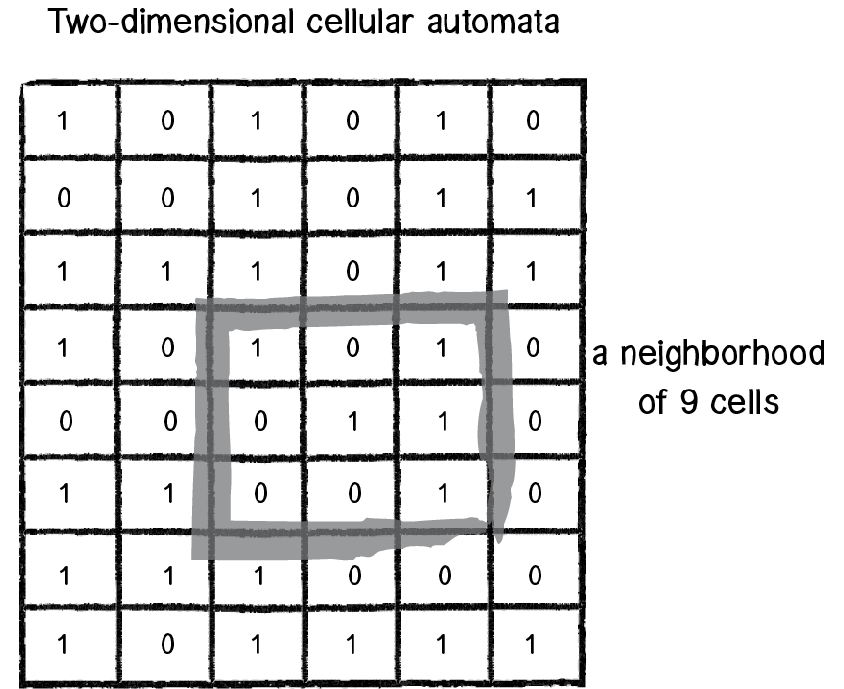
MOORE’S NEIGHBOURHOOD
The automaton is an example of a universal Turing machine: that is, anything that can be computed algorithmically can be computed within the game
Each cell in this automaton will have a neighbourhood with nine cells. Since we have 9 bits, 512 or (2⁹) configurations are possible. It would be impractical to define an outcome for every single possibility ,so it gets around this problem by defining a set of rules

Slide 8
Conway's Game Of Life – The Rules
A cell can die if
The cell is alive and has fewer than two live neighbours (loneliness)
The cell is alive and has more than three live neighbours (overpopulation)
A cell can reborn if
The cell is dead and has exactly three live neighbours (reproduction)

Slide 9
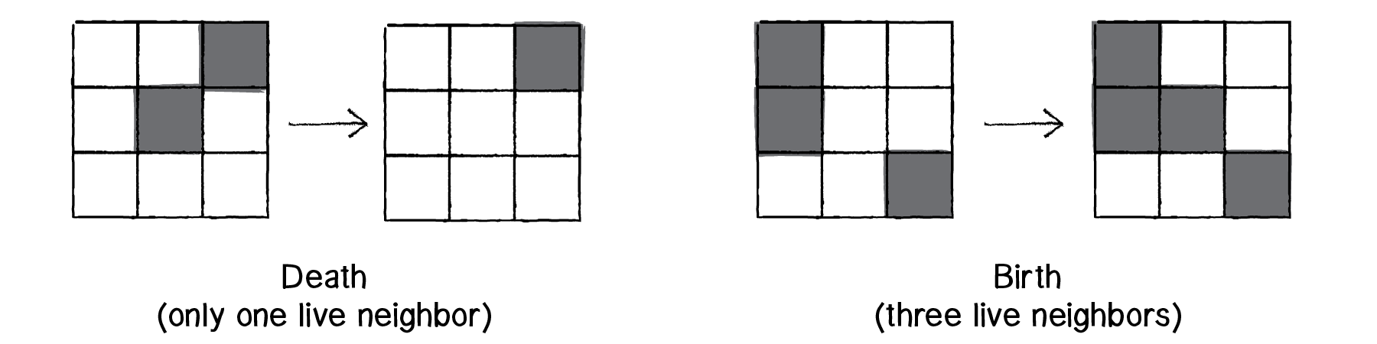
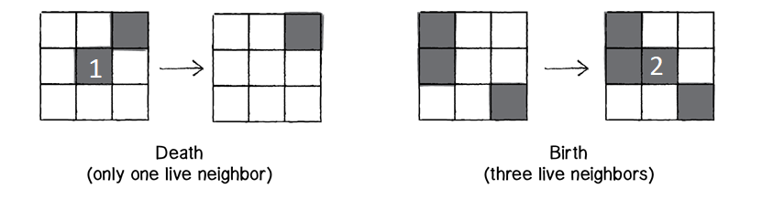
Conway's Game Of Life – The Rules
A cell remains in its current state(in stasis) if
The cell is alive and has two or three live neighbours
The cell is dead and has anything other than three live neighbours

Slide 10
AN IDEA BEHIND THE RULES
Conway chose his rules carefully:
In brief, the rules should be such as to make the behavior of the population unpredictable
There should be initial patterns that only apparently do grow without limit.
There should be no initial pattern for which there is a simple proof that the population can grow without limit.

Slide 11
AN IDEA BEHIND THE RULES
There should be simple initial patterns that grow and change for a considerable period of time before coming to end in three possible ways:
Fading away completely (from overcrowding or becoming too sparse)
Settling into a stable configuration that remains unchanged thereafter
Entering an oscillating phase in which they repeat an endless cycle of 2 or more periods

Slide 12
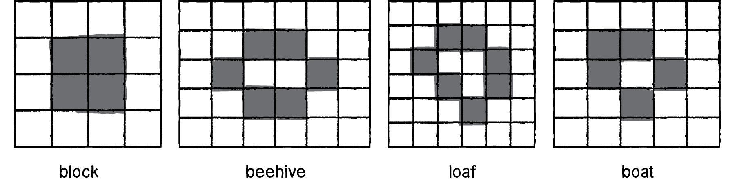
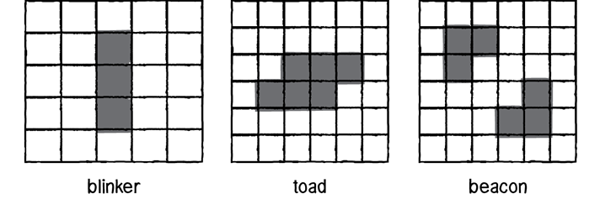
PATTERNS-EXAMPLES
STATIC PATTERNS
OSCILLATING PATTERNS

Slide 13
THANK YOU

